Slide 1
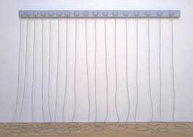
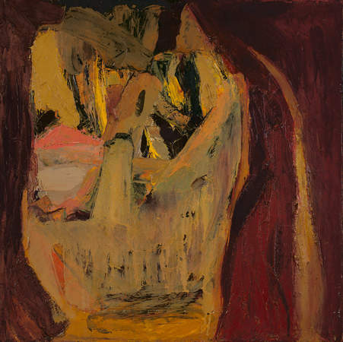
Eva Hesse

Slide 2
Early Life
Hesse was born in Hamburg, Germany on January 11, 1936
She and her sister escaped the Nazi’s via a children’s train to Amsterdam.
Kept many diaries as she grew up and that need autobiography influenced her works of art.

Slide 3
The escape, divorce, suicide of her mother, and other trauma of her early life affected her emotional development.
She started psychiatric therapy when young and continued with it throughout her life. This therapy encouraged self-analysis. The self-analysis helped her create innovative and original sculpture.

Slide 4
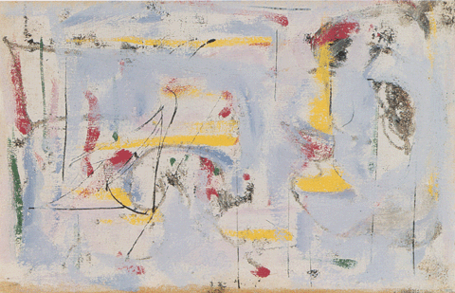
Her Art Throughout Her Life
At 16 she worked as a layout artist for Seventeen Magazine.
At Yale University, she studied color Theory with Joseph Albers.
Her paintings and drawings were mostly small and very personal.

Slide 5
In 1962, she married sculptor Tom Doyle and moved to Germany. They were guests of a textile manufacturer. Her work was influenced by machine parts from abandoned factories and the sculptural shapes from Doyles sculpture.
Began to explore sculpture

Slide 6
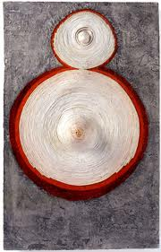
Ring Around Arosie , 1965

Slide 7
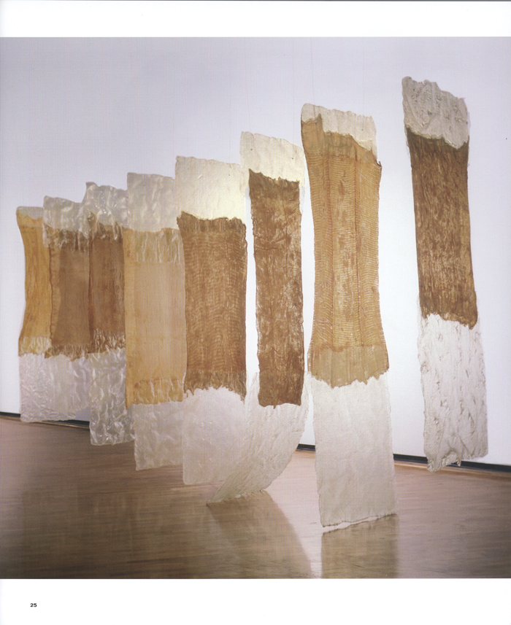
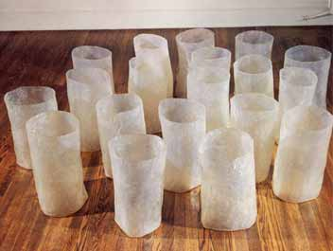
Pioneered the use of non-traditional materials, such as plastics, cloth, and industrial wire.
Untitled, 1967
Untitled, 1967

Slide 8
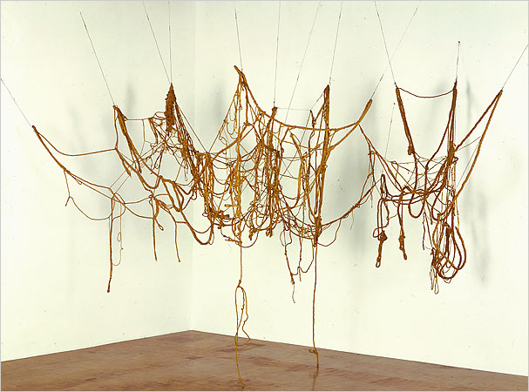
l
Untitled, 1970

Slide 9
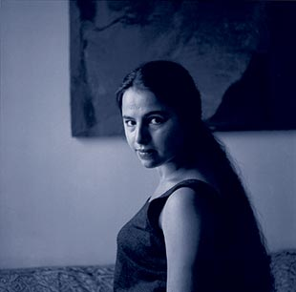
May 17, she died of brain cancer at age 37

